Slide 1
Study session 15 Derivatives
Reading 45
Derivative Markets and Instruments
Reading 46
Basics of Derivative Pricing and Valuation

Slide 2
Reading 46 Basics of Derivative Pricing and Valuation
a. explain how the concepts of arbitrage, replication, and risk neutrality are used in pricing derivatives;
b. explain the difference between value and price of forward and futures contracts;
c. calculate a forward price of an asset with zero, positive, or negative net cost of carry;
d. explain how the value and price of a forward contract are determined at expiration, during the life of the contract, and at initiation;
e. describe monetary and nonmonetary benefits and costs associated with holding the underlying asset and explain how they affect the value and price of a forward contract;
f. define a forward rate agreement and describe its uses;
g. explain why forward and futures prices differ;

Slide 3
Reading 46 Basics of Derivative Pricing and Valuation
h. explain how swap contracts are similar to but different from a series of forward contracts;
i. explain the difference between value and price of swaps;
j. explain the exercise value, time value, and moneyness of an option;
k. identify the factors that determine the value of an option and explain how each factor affects the value of an option;
l. explain put–call parity for European options;
m. explain put–call–forward parity for European options;
n. explain how the value of an option is determined using a one-period binomial model;
o. explain under which circumstances the values of European and American options differ.

Slide 4
Basic Derivative Concepts
A forward contract is an over-the-counter derivative contract in which two parties agree that one party, the buyer, will purchase an underlying asset from the other party, the seller, at a later date at a fixed price they agree upon when the contract is signed.
A futures contract is a standardized derivative contract created and traded on a futures exchange in which two parties agree that one party, the buyer, will purchase an underlying asset from the other party, the seller, at a later date at a price agreed upon by the two parties when the contract is initiated and in which there is a daily settling of gains and losses and a credit guarantee by the futures exchange through its clearinghouse

Slide 5
Basic Derivative Concepts
A swap contract is an over-the-counter derivative contract in which two parties agree to exchange a series of cash flows whereby one party pays a variable series that will be determined by an underlying asset or rate and the other party pays either 1) a variable series determined by a different underlying asset or rate or 2) a fixed series.
An option is a derivative contract in which one party, the buyer, pays a sum of money to the other party, the seller or writer, and receives the right to either buy or sell an underlying asset at a fixed price either on a specific expiration date or at any time prior to the expiration date.

Slide 6
Basic Derivative Concepts
A derivative is a financial instrument that derives its performance from the performance of an underlying asset.

Slide 7
Pricing the Underlying
The price of a financial asset is often determined using a present value of future cash flows approach.
The value of the financial asset is the expected future price plus any interim payments such as dividends or coupon interest discounted at a rate appropriate for the risk assumed.
The risk aversion of the investor
We can generally characterize three potential types of investors by how they feel about risk: risk averse, risk neutral, or risk seeking

Slide 8
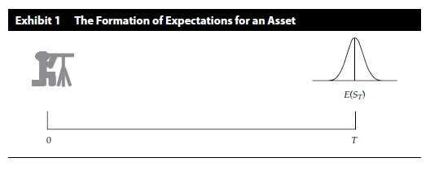
Pricing the Underlying
The formation of expectations

Slide 9
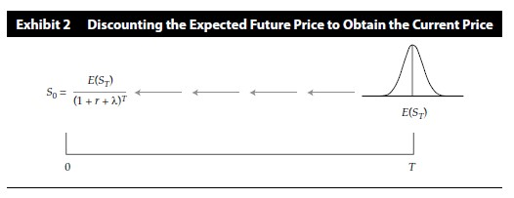
Pricing the Underlying
The required rate of return on the underlying asset
The pricing of risky assets

Slide 10
Pricing the Underlying
Other benefits and costs of holding an asset
Benefit
Monetary: dividend, interest
Non-monetary: convenience yield
Cost
Cost of storage
Opportunity cost of money invested

Slide 11
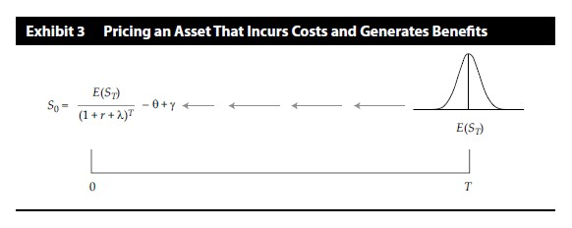
Pricing the Underlying
The net of costs and benefits is often referred to by the term carry, or sometimes cost of carry.
We use the symbol θ (theta) to denote the present value of the costs and γ (gamma) as the present value of any benefits.

Slide 12
Practices
1 Which of the following factors does not affect the spot price of an asset that has no interim costs or benefits?
A The time value of money
B The risk aversion of investors
C The price recently paid by other investors
2 Which of the following does not represent a benefit of holding an asset?
A The convenience yield
B An optimistic expected outlook for the asset
C Dividends if the asset is a stock or interest if the asset is a bond

Slide 13
Pricing and Valuation of Forward
The forward, futures, or swap price is a concept that represents the fixed price or rate at which the underlying will be purchased at a later date.
In the financial world, we generally define value as the value to the long position

Slide 14
Pricing and Valuation of Forward Initiation
When a forward contract is initiated, neither party pays anything to the other. It is a valueless contract, neither an asset nor a liability. Therefore, its value at initiation is zero:
V₀(T) = 0

Slide 15
Pricing and Valuation of Forward Initiation
We can easily solve for the forward price to obtain
F₀(T) = S₀(1 + r)^{T}
The forward price is the spot price compounded at the risk-free rate over the life of the contract
Now suppose the asset generates cash payments and/or benefits and incurs storage costs.
F₀(T) = (S₀-γ₀+θ₀)(1 + r)^{T}

Slide 16
Pricing and Valuation of Forward Expiration
The forward price, established at the initiation date of contract is F₀(T). Let us denote the value at expiration of the forward contract as V_{T}(T). This value is formally stated as
V_{T}(T) = S_{T} – F₀(T)

Slide 17
Pricing and Valuation of Forward Between Initiation and Expiration
In general, we can say that:
The value of a forward contract is the spot price of the underlying asset minus the present value of the forward price.
V_{t}(T) = S_{t} – F₀(T)(1 + r)^{–(T–t)}
If the asset has a cost of carry, we must make only a small adjustment:
V_{t}(T) = S_{t} – (γ₀ – θ₀)(1 + r)^{t} – F₀(T)(1 + r)^{–(T–t)}

Slide 18
Practices
1 Which of the following best describes the difference between the price of a forward contract and its value?
A The forward price is fixed at the start, and the value starts at zero and then changes.
B The price determines the profit to the buyer, and the value determines the profit to the seller.
C The forward contract value is a benchmark against which the price is compared for the purposes of determining whether a trade is advisable.

Slide 19
Practices
2 Which of the following best describes the value of the forward contract at expiration? The value is the price of the underlying:
A minus the forward price.
B divided by the forward price.
C minus the compounded forward price.
3 Which of the following factors does not affect the forward price?
A The costs of holding the underlying
B Dividends or interest paid by the underlying
C Whether the investor is risk averse, risk seeking, or risk neutral

Slide 20
Forward Rate Agreement
Spot rate and forward rate
Forward contracts in which the underlying is an interest rate are called forward rate agreements, or FRAs.
FRAs have often historically been based on Libor, the London Interbank Offered Rate.
30-Day FRA on 90-Day Libor
3*12 FRA

Slide 21
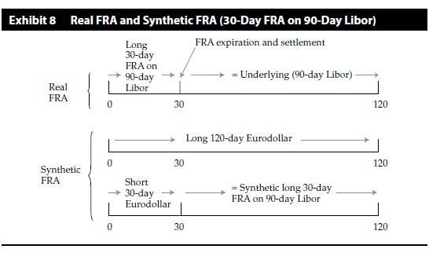
Forward Rate Agreement

Slide 22
Practices
Which of the following best describes the forward rate of an FRA?
A The spot rate implied by the term structure
B The forward rate implied by the term structure
C The rate on a zero-coupon bond of maturity equal to that of the forward contract

Slide 23
Pricing and Valuation of Futures
Futures price=110, initial margin=11, maintenance margin=6
 | Beginning Balance | Fund Deposit | Futures( settlement) price | Gain/Loss | Ending Balance
Day 0 | 0 | 11 | 110 | 0 | 11
Day 1 | 11 | 0 | 108 | -2 | 9
Day 2 | 9 | 0 | 104 | -4 | 5
Day 3 | 5 | 6 | 100 | -4 | 7
Day 4 | 7 | 0 | 102 | 2 | 9
Day 5 | 9 | 0 | 98 | -4 | 5
Day 6 | 5 | 6 | 100 | 2 | 13

Slide 24
Pricing and Valuation of Futures
The value of a futures contract is the accumulated gain or loss on a futures contract since its previous day’s settlement.
When that value is paid out in the daily settlement, the futures price is effectively reset to the settlement price and the value goes to zero.

Slide 25
Pricing and Valuation of Futures
The different patterns of cash flows for forwards and futures can lead to differences in the pricing of forwards versus futures. But there are some conditions under which the pricing is the same.
1. The interest rates were constant.
2. Futures prices and interest rates are uncorrelated.

Slide 26
Pricing and Valuation of Futures
Futures price and interest rate(long position)
Positive correlation
Futures price > forward price
Negative correlation
Futures price < forward price

Slide 27
Practices
1 Which of the following best describes how futures contract payoffs differ from forward contract payoffs?
A Forward contract payoffs are larger.
B They are equal, ignoring the time value of money.
C Futures contract payoffs are larger if the underlying is a commodity.
2 Which of the following conditions will not make futures and forward prices equivalent?
A Interest rates are constant.
B Futures prices are uncorrelated with interest rates.
C The volatility of the forward price is different from the volatility of the futures price.

Slide 28
Practices
3 With respect to the value of a futures contract, which of the following statements is most accurate? The value is the:
A futures price minus the spot price.
B present value of the expected payoff at expiration.
C accumulated gain since the previous settlement, which resets to zero upon settlement.

Slide 29
Pricing and Valuation of Swap
We will let this swap be the type that involves a fixed payment exchanged for a floating payment.
breaks down a swap into a series of implicit forward contracts, with the expiration of each forward contract corresponding to a swap payment date.

Slide 30
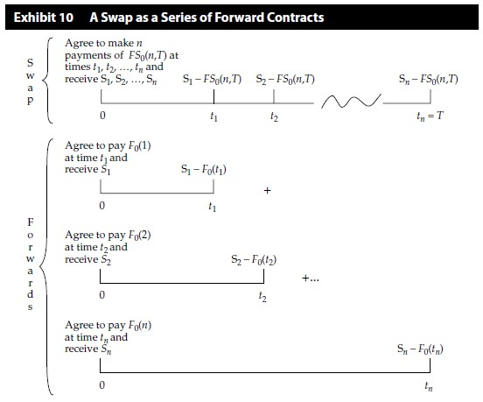
Pricing and Valuation of Swap

Slide 31
Pricing and Valuation of Swap
Zero value is essential if there is no exchange of cash flows from one party to the other.
And although no exchange of cash flows is customary, it is not mandatory.
A forward transaction that starts with a zero value is called an at-market forward.
A forward transaction that starts with a nonzero value is called an off-market forward.

Slide 32
Practices
1 A swap is equivalent to a series of:
A forward contracts, each created at the swap price.
B long forward contracts, matched with short futures contracts.
C forward contracts, each created at their appropriate forward prices.
2 If the present value of the payments in a forward contract or swap is not zero, which of the following is most likely to be true?
A The contract cannot legally be created.
B The contract must be replicated by another contract with zero value.
C The party whose stream of payments to be received is greater has to pay the other party the present value difference.

Slide 33
Pricing and Valuation of Option
Definition: An option is a derivative contract in which one party, the buyer, pays a sum of money to the other party, the seller or writer, and receives the right to either buy or sell an underlying asset at a fixed price either on a specific expiration date or at any time prior to the expiration date.

Slide 34
Pricing and Valuation of Option European Option
Value of a European option at expiration
C_{T} = Max(0,S_{T} – X)
P_{T} = Max(0,X – S_{T})
This formula is also sometimes referred to as the exercise value or intrinsic value.

Slide 35
Pricing and Valuation of Option European Option
The element in determining the value of an option
 | Call Option | Put Option
The underlying | Directly related | Inversely related
The exercise price | Inversely related | Directly related
Time to expiration | Directly related | Directly related*
Rf rate | Directly related | Inversely related
Volatility of underlying | Directly related | Directly related
Payment on the underlying | Inversely related | Directly related
Cost of carry | Directly related | Inversely related

Slide 36
Pricing and Valuation of Option European Option
The inverse effect can prevail with a put the longer the time to expiration, the higher the risk-free rate, and the deeper it is in-the-money.
Th time value of an option is the difference between the market price of the option and its intrinsic value.
As such, an option price is said to decay over time, a process characterized as time value decay

Slide 37
Practices
1 Which of the following factors does not affect the value of a European option?
A The volatility of the underlying
B Dividends or interest paid by the underlying
C The percentage of the investor’s assets invested in the option
2 Which of the following statements imply that a European call on a stock is worth more?
A Less time to expiration
B A higher stock price relative to the exercise price
C Larger dividends paid by the stock during the life of the option

Slide 38
Practices
3 Why might a European put be worth less the longer the time to expiration?
A The cost of waiting to receive the exercise price is higher.
B The risk of the underlying is lower over a longer period of time.
C The longer time to expiration means that the put is more likely to expire out-of- the- money.
4 The loss in value of an option as it moves closer to expiration is called what?
A Time value decay
B Volatility diminution
C Time value of money

Slide 39
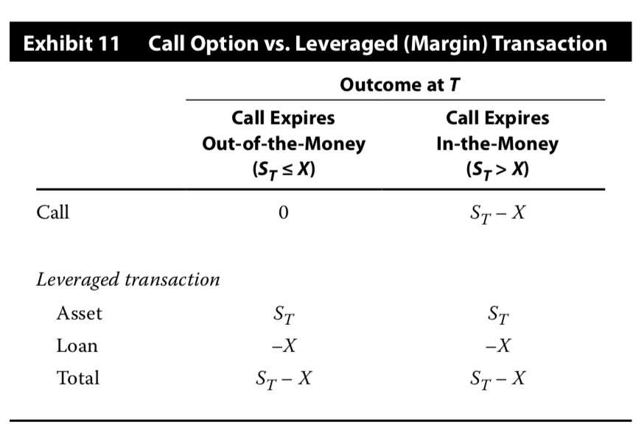
Pricing of European option lower limits of call option
C₀>=Max[0,S₀-X/(1+r)^{T}]
The lowest value of a European call is the greater of zero or the value of the underlying minus the present value of the exercise price.

Slide 40
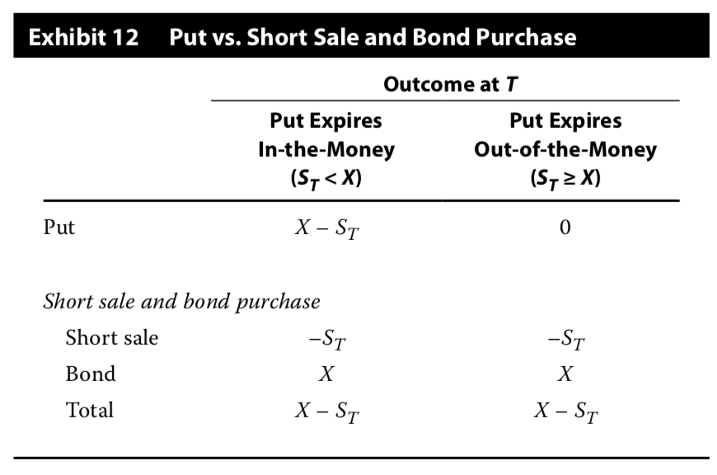
Pricing of European option lower limits of put option
P₀>=Max[0,X/(1+r)^{T}-S₀]
The lowest value of a European put is the greater of zero or the present value of the exercise price minus the value of the underlying.

Slide 41
Practices
How does the minimum value of a call or put option differ from its exercise value?
A The exercise price is adjusted for the time value of money.
B The minimum value reflects the volatility of the underlying.
C The underlying price is adjusted for the time value of money.
Assume the exercise price is €60, the risk-free rate is 4%, and the expiration is nine months, so T = 9/12 = 0.75. Consider two cases: Underlying: S0 = €70

Slide 42
Put-Call Parity
S₀+P₀=C₀+X/(1+rf)^{T}
The strategy of holding the asset and a put is sometimes called a protective put.
The strategy of holding a call and the risk-free zero-coupon bond with a face value of X that matures at T is sometimes called a fiduciary call.
The strategy seems like a reasonable and possibly quite attractive investment. Investor receives the benefit of unlimited upside potential, with the downside performance truncated at X.

Slide 43
Put-Call Parity
We can rearrange the put–call parity equation in the following ways:
S₀=C₀-P₀+X/(1+rf)^{T}→ long asset=long call, short put, long bond
P₀=C₀-S₀+X/(1+rf)^{T}
C₀=S₀+P₀-X/(1+rf)^{T}
X/(1+rf)^{T} =S₀+P₀-C₀

Slide 44
Put-Call Forward Parity
F₀(T)/(1+rf)^{T}+P₀=C₀+X/(1+rf)^{T}

Slide 45
Practices
1 Which of the following statements best describes put–call parity?
A The put price always equals the call price.
B The put price equals the call price if the volatility is known.
C The put price plus the underlying price equals the call price plus the present value of the exercise price.
2 From put–call parity, which of the following transactions is risk-free?
A Long asset, long put, short call
B Long call, long put, short asset
C Long asset, long call, short bond

Slide 46
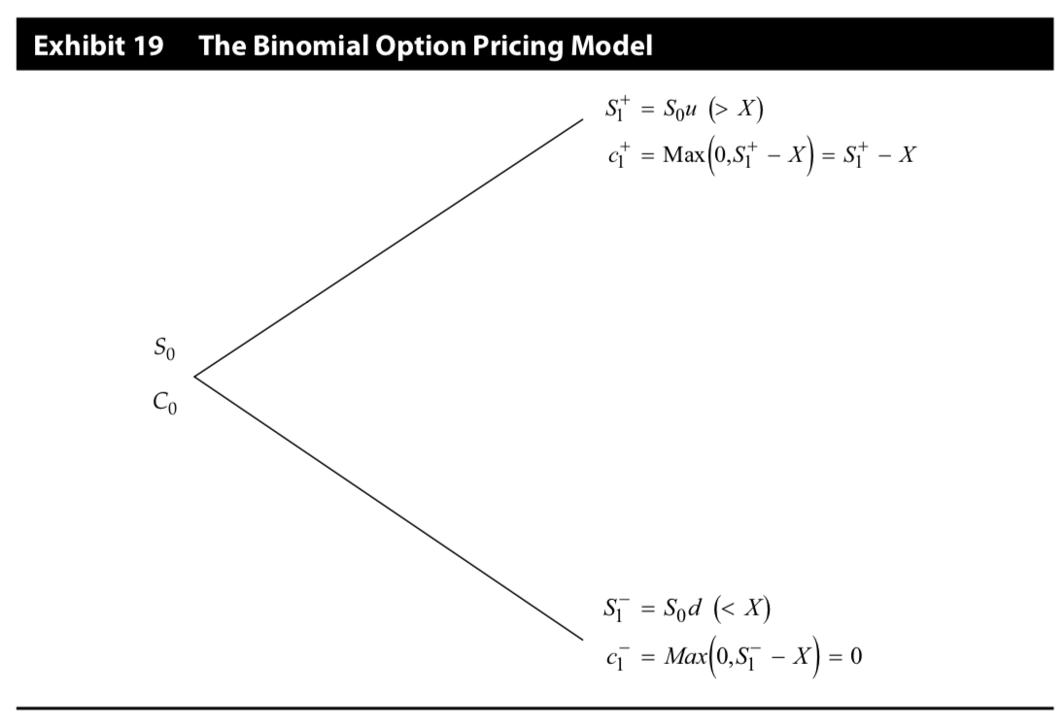
Binomial Valuation of Option
We will start with a very simple model that allows only two possible movements in the underlying—one going up and one going down from where it is now. This model with two possible outcomes is called the binomial model.

Slide 47

Binomial Valuation of Option
u=S₁⁺/S₀
d=S₁⁻/S₀
𝜋_{u}=$\frac{1+r−d}{u−d}$
𝜋_{u}+𝜋_{d}=1
C0= $\frac{\text{π}\text{u}\text{*}\text{c}\text{1++}\text{π}\text{d}∗C1−}{1+r}$

Slide 48
Classification of derivatives Exchange-traded and OTC market
Exchange-traded derivative market
characteristics
Standardized
More liquid
Market makers and speculators
Clear and settle all contracts overnight
Credit guarantee
Transparency(regulatory bodies)
Loss of privacy and flexibility

Slide 49
Classification of derivatives Exchange-traded and OTC market
Over-the-counter derivative market
characteristics
Customization
More flexible
Lower degree of regulation
Retain a degree of privacy with lower transparency

Slide 50
Practices
1.Which of the following is not a forward commitment?
A An agreement to take out a loan at a future date at a specific rate
B An offer of employment that must be accepted or rejected in two weeks
C An agreement to lease a piece of machinery for one year with a series of fixed monthly payments
2.Which of the following statements is true about contingent claims?
A Either party can default to the other.
B The payoffs are linearly related to the performance of the underlying.
C The most the long can lose is the amount paid for the contingent claim.

Slide 51
Practices
3.Which of the following characteristics is not associated with exchange-traded derivatives?
A Margin or performance bonds are required.
B The exchange guarantees all payments in the event of default.
C All terms except the price are customized to the parties’ individual needs.
4.Which of the following characteristics is associated with over- the- counter derivatives?
A Trading occurs in a central location.
B They are more regulated than exchange- listed derivatives.
C They are less transparent than exchange- listed derivatives.

Slide 52
Practices
5.Market makers earn a profit in both exchange and over- the- counter derivatives markets by:
A charging a commission on each trade.
B a combination of commissions and markups.
C buying at one price, selling at a higher price, and hedging any risk.
6.Which of the following statements most accurately describes exchange-traded derivatives relative to over- the- counter derivatives? Exchange-traded derivatives are more likely to have:
A greater credit risk.
B standardized contract terms.
C greater risk management uses

Slide 53
The purposes and benefits of derivatives
The origin of modern futures markets is the creation of the Chicago board of trade in 1848.
‘To-arrive’ contract

Slide 54
The purposes and benefits of derivatives
Risk allocation , transfer , and management
Information discovery
Operational advantages
Market efficiency

Slide 55
Practices
1.Which of the following is not an advantage of derivative markets?
A They are less volatile than spot markets.
B They facilitate the allocation of risk in the market.
C They incur lower transaction costs than spot markets.
2.Which of the following pieces of information is not conveyed by at least one type of derivative?
A The volatility of the underlying
B The most widely used strategy of the underlying
C The price at which uncertainty in the underlying can be eliminated

Slide 56
Criticisms and misuses of derivatives Speculation and gambling
Speculators are often thought to be short- term traders who attempt to exploit temporary inefficiencies.
Speculators are thought to engage in price manipulation and to trade at extreme prices.
The profits from short- term trading are almost always taxed more heavily than the profits from long- term trading.

Slide 57
Criticisms and misuses of derivatives Destabilization and Systemic Risk
Defaults by speculators can then lead to defaults by their creditors, their creditors’ creditors, and so on. These effects can, therefore, be systemic and reflect an epidemic contagion whereby instability can spread throughout markets and an economy, if not the entire world.
Such effects occurred in the Long- Term Capital Management fiasco of 1998 and again in the financial crisis of 2008, in which derivatives, particularly credit default swaps, were widely used by many of the problem entities.
Some of these events preceded the era of modern derivatives markets, and others were completely unrelated to the use of derivatives.
Another criticism of derivatives is simply their complexity.
One explanation probably lies in the fact that scientists create models of markets by using scientific principles that often fail.

Slide 58
Practices
1.Which of the following responds to the criticism that derivatives can be destabilizing to the underlying market?
A Market crashes and panics have occurred since long before derivatives existed.
B Derivatives are sufficiently regulated that they cannot destabilize the spot market.
C The transaction costs of derivatives are high enough to keep their use at a minimum level.

Slide 59
Elementary principles of derivative pricing
F_{T}=(S₀+cost₀-benefit₀)*(1+rf)^{T}

Slide 60
Elementary principles of derivative pricing-Storage
Storage incurs costs.(commodity)
Some assets pay returns during storage.(financial asset)

Slide 61
Elementary principles of derivative pricing-Arbitrage
In well- functioning markets with low transaction costs and a free flow of information, the same asset cannot sell for more than one price.
For this reason, arbitrage is often referred to as the law of one price.
This trade would get profit at no risk and not require the commitment of any of the investor’s capital.
To summarize, the forces of arbitrage in financial markets assure us that the same asset cannot sell for different prices, nor can two equivalent combinations of assets that produce the same results sell for different prices.

Slide 62
Elementary principles of derivative pricing-Arbitrage
Tencent A:600 B:610

Slide 63
Elementary principles of derivative pricing-Arbitrage
Tencent S₀=500, F₁=530 , RF=4%

Slide 64
Elementary principles of derivative pricing-Arbitrage
Tencent S₀=500, F₁=510 , RF=4%

Slide 65
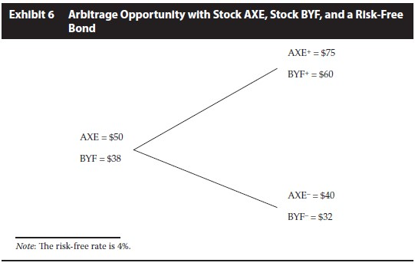
Elementary principles of derivative pricing-Arbitrage

Slide 66
Practices
1 Which of the following is a result of arbitrage?
A The law of one price
B The law of similar prices
C The law of limited profitability
2 When an arbitrage opportunity exists, what happens in the market?
A The combined actions of all arbitrageurs force the prices to converge.
B The combined actions of arbitrageurs result in a locked- limit situation.
C The combined actions of all arbitrageurs result in sustained profits to all.

Slide 67
Practices
3 Which of the following accurately defines arbitrage?
A An opportunity to make a profit at no risk
B An opportunity to make a profit at no risk and with the investment of no capital
C An opportunity to earn a return in excess of the return appropriate for the risk assumed
4 Which of the following ways best describes how arbitrage contributes to market efficiency?
A Arbitrage penalizes those who trade too rapidly.
B Arbitrage equalizes the risks taken by all market participants.
C Arbitrage improves the rate at which prices converge to their relative fair values.

